Slide 1




HEART DISEASE
Machine Learning project
MARYAM ALAAMRI
MARWA SAAR

Slide 2

Contents we will discuss
Introduction
01
Dataset Description
02
Data Preprocessing
03
Model Building
04
Interpretation
05
Conclusion
06

Slide 3

Introduction
Heart disease is a leading cause of death worldwide. Early detection through accurate prediction can improve patient outcomes. This project builds and evaluates machine learning classification models to predict heart disease using patient indicators like age, blood pressure, cholesterol, and exercise, focusing on data exploration, preprocessing, model training, and performance evaluation, apply different classification algorithms, and improve model performance while ensuring reliable evaluation.

Slide 4

Age of the patient
Gender of the patient (1 = male, 0 = female)
Chest pain type (0,1,2,3)
Resting blood pressure
Serum cholesterol
Fasting blood sugar (>120 mg/dl: 1 = true, 0 = false)
Resting electrocardiographic results
Dataset description
Exercise-induced angina (1 = yes, 0 = no)
Maximum heart rate achieved
ST depression induced by exercise
Slope of the peak exercise ST segment
Number of major vessels colored by fluoroscopy
Thalassemia type (1,2,3)
The dataset used in this project is based on the UCI Heart Disease dataset, which contains clinical and demographic information related to cardiovascular health.

Slide 5

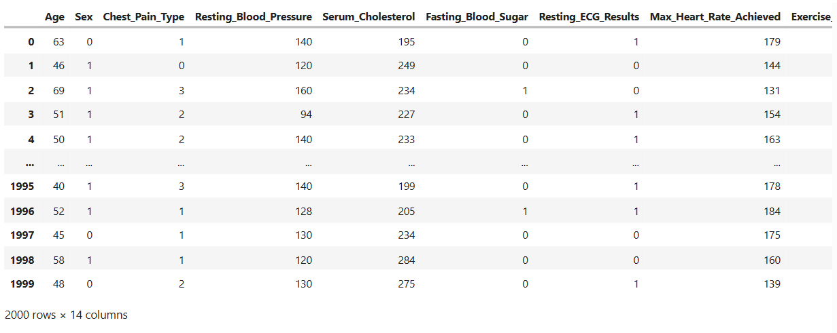


Data Preprocessing

Slide 6
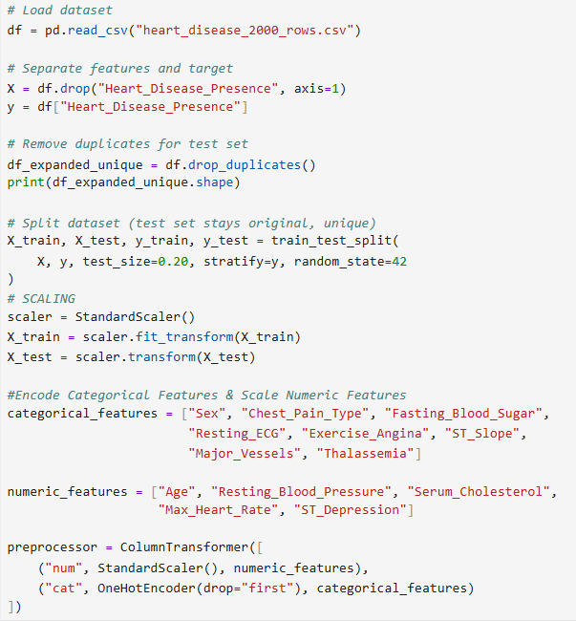
Data Preprocessing
Exploratory Data Analysis (EDA)
Class distribution analysis
Correlation heatmap
Feature–target relationship visualization
Detection of duplicated rows
Data Preprocessing
Encoding categorical features
Scaling numerical features using standardization
Train–test split with stratification

Slide 7
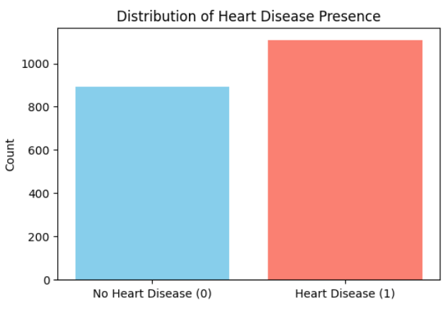

Data Preprocessing
This indicates a slightly imbalanced dataset, which was considered during model evaluation.
Target Variable:
Heart_Disease_Presence
1 → Presence of heart disease
0→ Absence of heart disease
Class Distribution
Heart disease present: 1108 samples
No heart disease: 892 samples

Slide 8
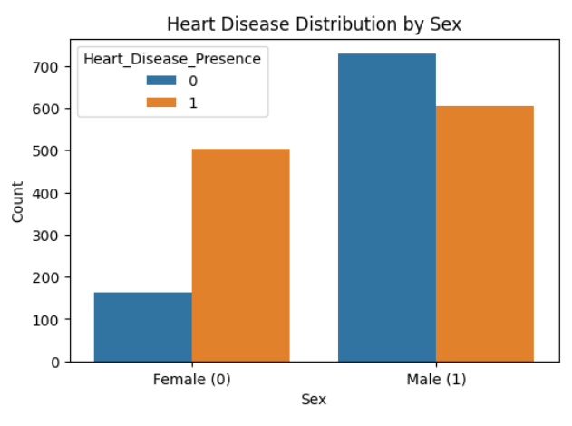

Exploratory Data Analysis (EDA)
Males show a higher proportion of heart disease compared to females, indicating that sex is a significant risk factor in predicting heart disease.

Slide 9
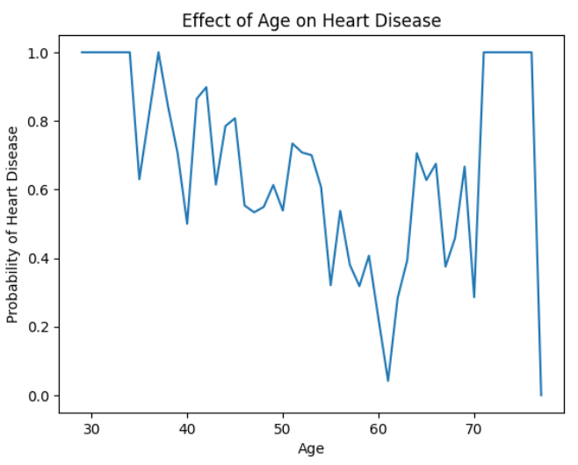

Exploratory Data Analysis (EDA)
The probability of heart disease increases steadily with age, indicating age is a strong risk factor

Slide 10
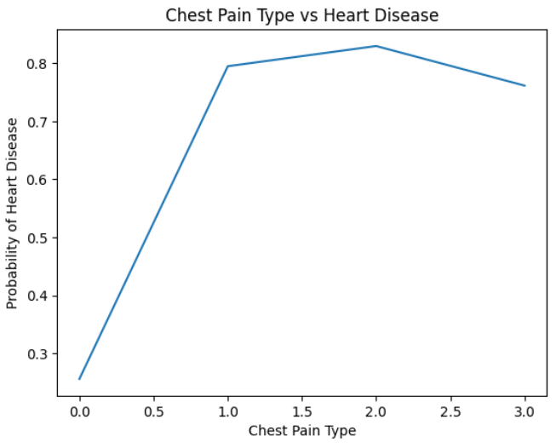

Exploratory Data Analysis (EDA)
Certain chest pain categories show significantly higher heart disease prevalence

Slide 11

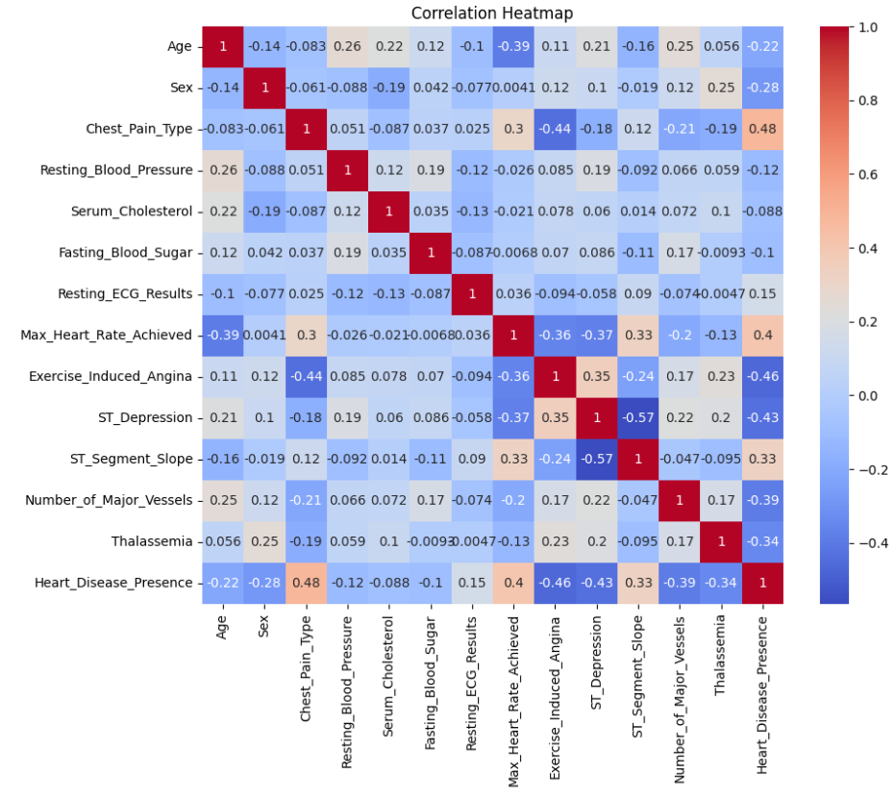
Exploratory Data Analysis (EDA)
The correlation analysis reveals that chest pain type, ECG abnormalities, exercise-induced angina, and heart rate metrics are the strongest predictors of heart disease, while cholesterol and fasting blood sugar show relatively weak influence.

Slide 12
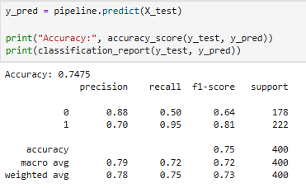
Model Building
Classification Report

Slide 13
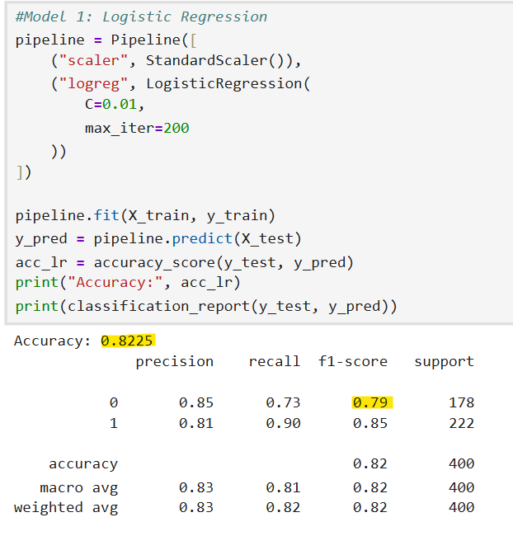
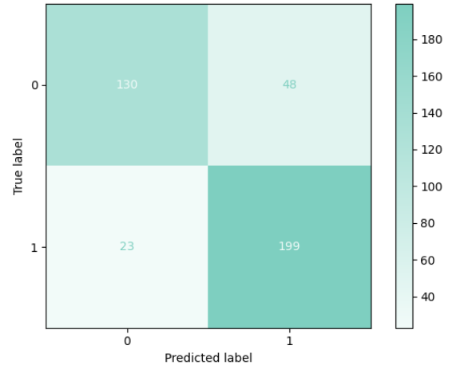
Model Building
1-Logistic Regression
Confusion Matrix

Slide 14
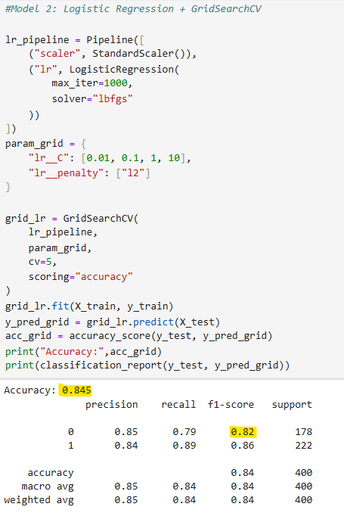
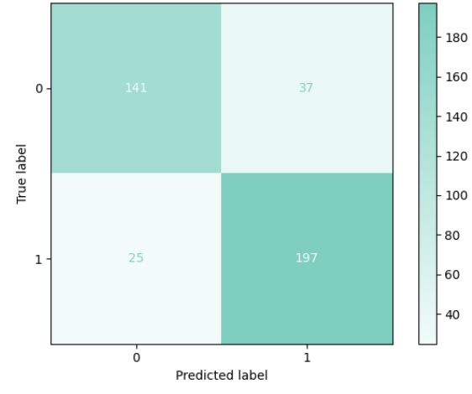
Model Building
2.Logistic Regression + GridSearchCV
Confusion Matrix

Slide 15
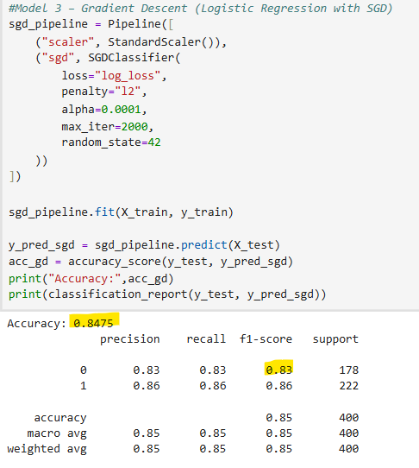
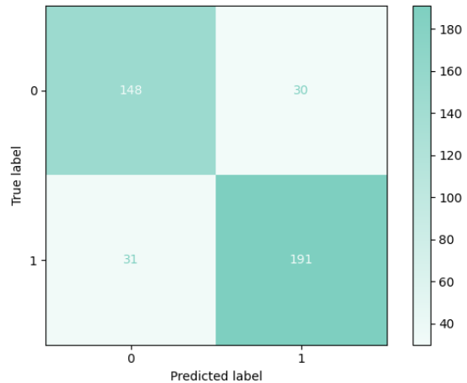
Model Building
3-Gradient Descent (Logistic Regression with SGD)
Confusion Matrix

Slide 16
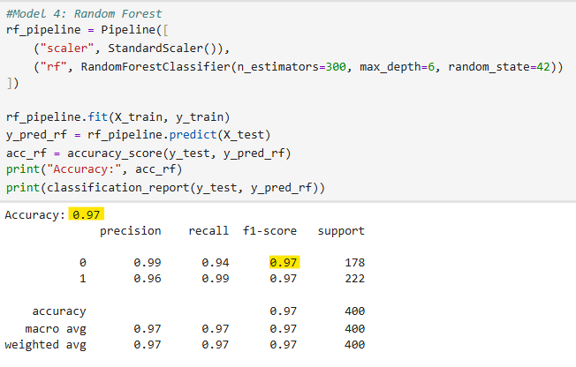
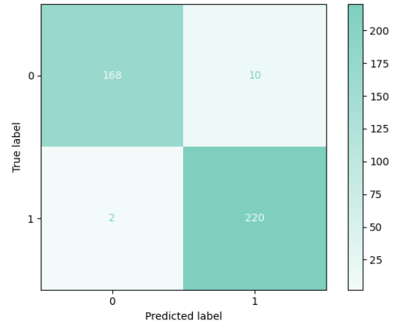
Model Building
4-Random Forest
Confusion Matrix

Slide 17
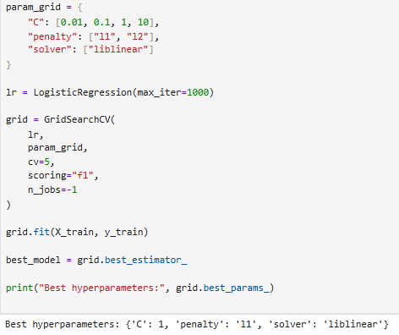
Best hyperparameters
C = 1 is best: It gives the best balance between underfitting (too simple) and overfitting (too complex), resulting in the highest average F1-score during 5-fold cross-validation.
L1 penalty is best: L1 removes weak or noisy features by setting some coefficients to zero, which improves generalization and F1-score on your dataset.
liblinear solver fits your setup It supports L1 regularization, works well with small datasets, and was the solver tested, so it produced the most stable and best-performing result. That’s why GridSearchCV selected these hyperparameters.

Slide 18
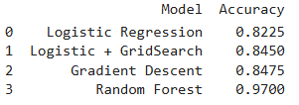
Compare Accuracy between 4 models
Random Forest performed best (0.97), far outperforming Logistic Regression (0.8225) and its tuned/gradient variants (0.8450–0.8475), showing that ensemble methods capture patterns more effectively.

Slide 19
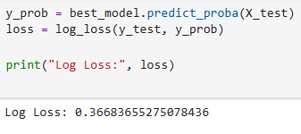
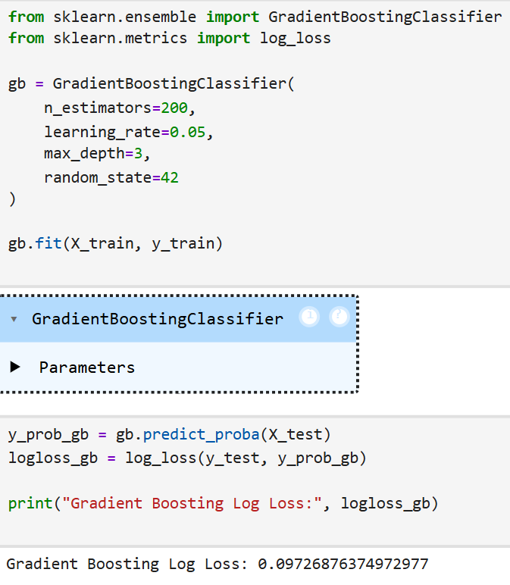
Log Loss (Cross-Entropy)
Log Loss BEFORE GridSearch (baseline model)
Log Loss After GridSearch (baseline model)
كلما كانت Log Loss أقل → النموذج أكثر ثقة ودقة في الاحتمالات

Slide 20
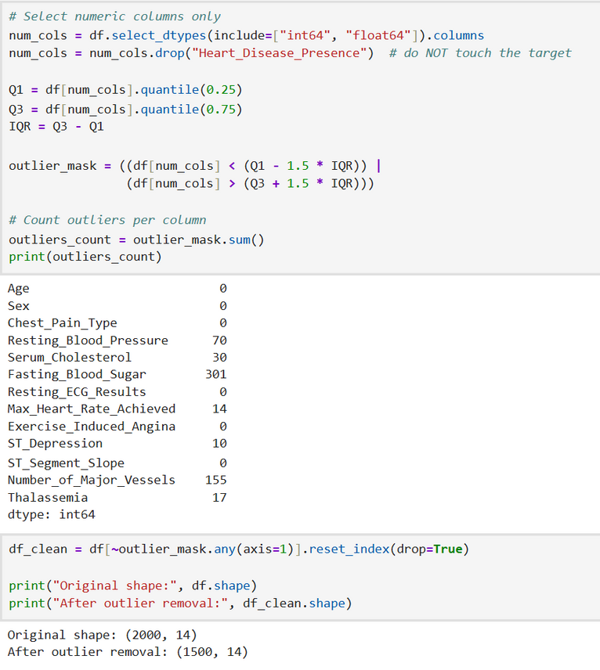
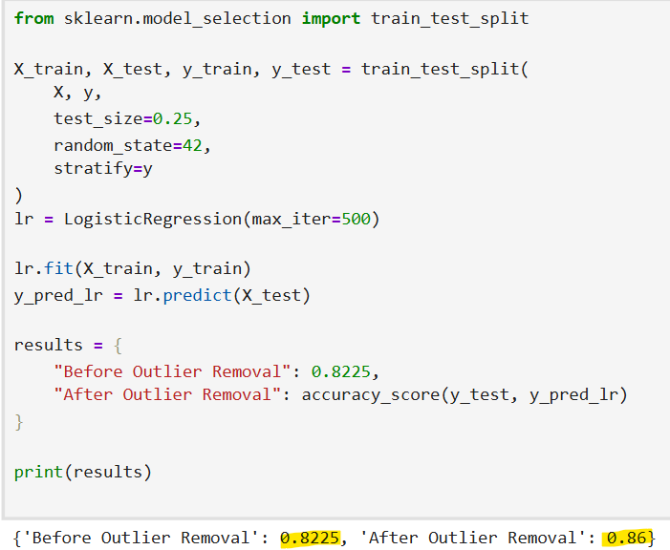
Checking Outlier
Outlier
Logistic Regression after remove Outlier

Slide 21
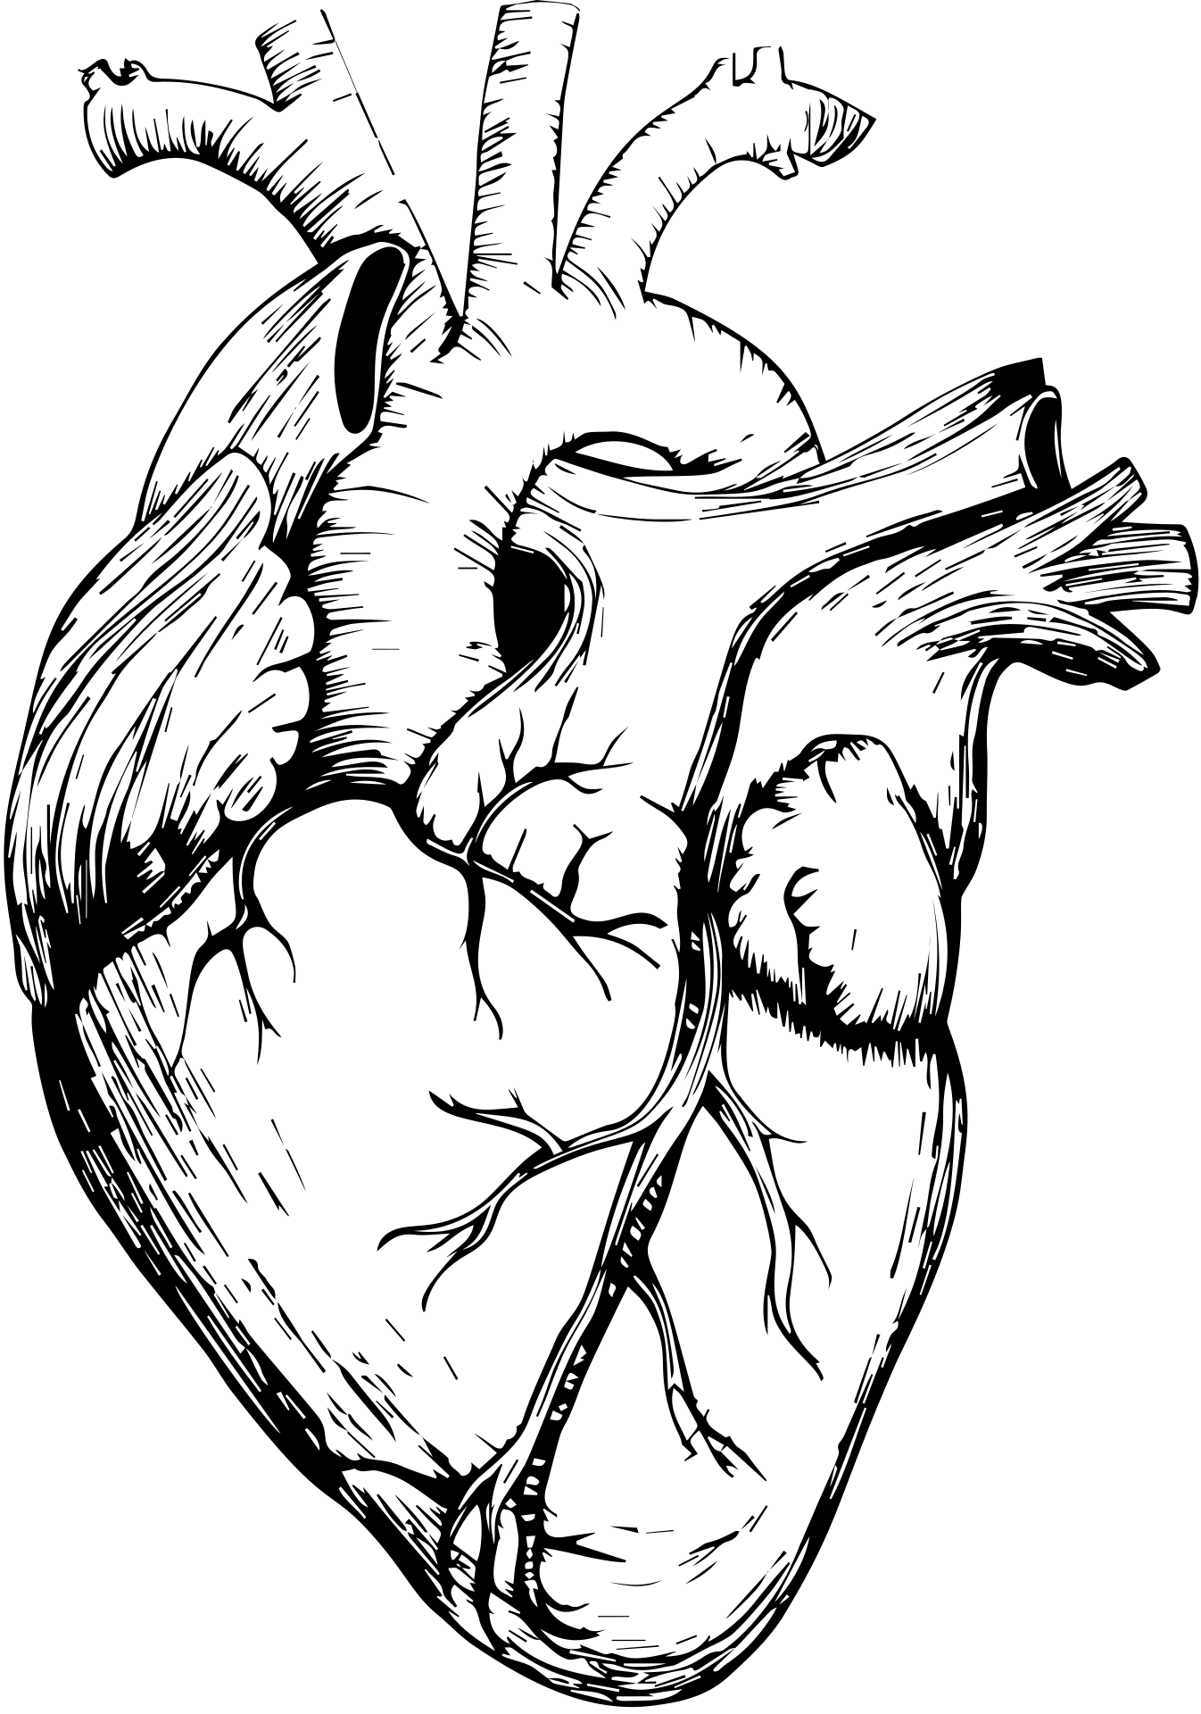
Interpretation
Logistic Regression was used for its suitability in binary classification and interpretability, important in medical settings. It achieved balanced precision, recall, and F1-score, ensuring reliable detection of heart disease, with recall being crucial to avoid missing critical cases. Feature analysis highlighted age, chest pain type, maximum heart rate and exercise as key predictors. Among the four models tested, Random Forest performed best, achieving the highest accuracy.

Slide 22

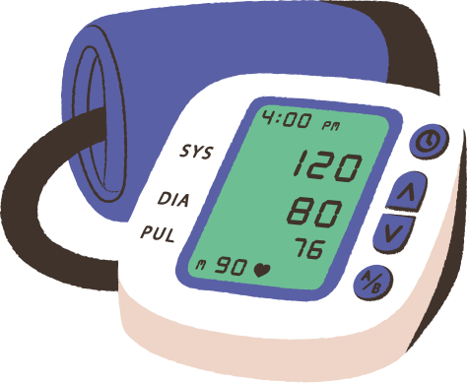

Conclusion
This project demonstrated the effectiveness of machine learning
classification techniques in heart disease using clinical
and demographic features. Random Forest, combined with proper
preprocessing and hyperparameter tuning, achieved reliable and
interpretable results.
Feature analysis showed that chest pain type, age, heart rate, and
exercise-related indicators play a crucial role in heart disease
prediction, which aligns with established medical knowledge.
The model showed good generalization with no strong evidence of
overfitting. Future work may include advanced ensemble models,
handling class imbalance with resampling techniques, and validating
the model on external datasets for clinical deployment.

Slide 23

THANK
YOU

